Slide 1
Border Gateway Protocol (BGP)
Chapter Six

Slide 2
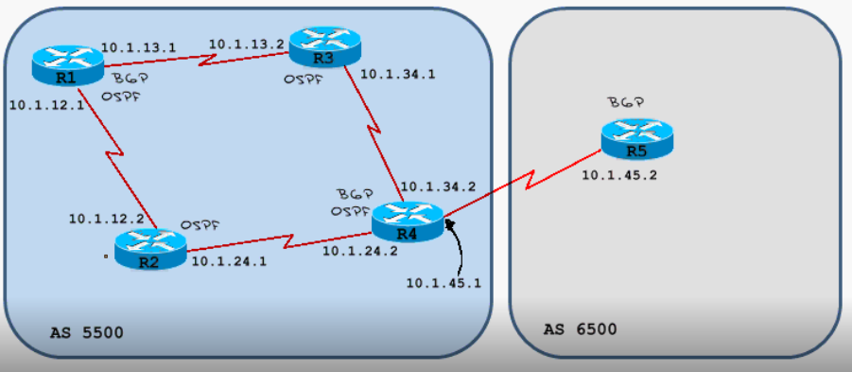
Configure it

Slide 3
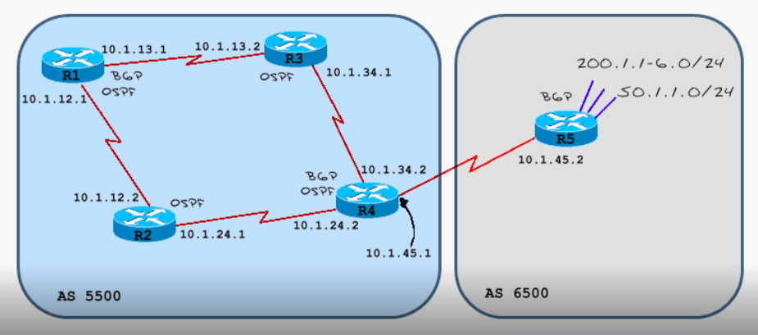
Advance BGP
Network command
Redistribute

Slide 4
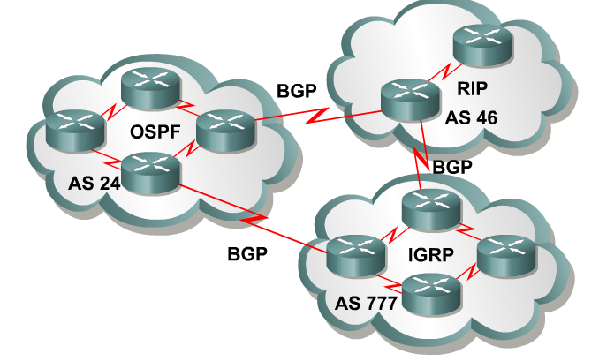
Terms
What is an IGP (Interior Gateway Protocol)?
  Routing protocol used to exchange routing information within an autonomous system.
  RIP, IGRP, EIGRP, OSPF, IS-IS
What is an EGP (Exterior Gateway Protocol)?
  Routing protocol used to exchange routing information between autonomous systems.
BGP (Border Gateway Protocol) is an Inter domain Routing Protocol (IDRP), which is also known as an EGP.
    BGP - is a path vector routing protocol.
What is an Autonomous System ?
  (From RFC 1771) “A set of routers under the single technical administration, using an IGP and common metrics to route packets within the AS, and using an EGP to route packets to other AS’s.”

Slide 5
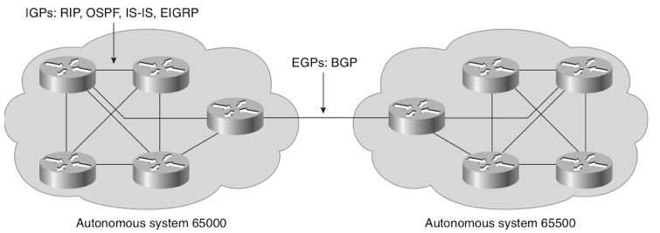
BGP version 4 (BGP-4) (latest version of BGP)
As noted in this RFC, the classic definition of an AS is “A set of routers under a single technical administration, using an Interior Gateway Protocol (IGP) and common metrics to determine how to route packets within the AS, and using an inter-AS routing protocol to determine how to route packets to other [autonomous systems].”
Extensions to BGP-4 (known as BGP4+) includes IPv6.

Slide 6
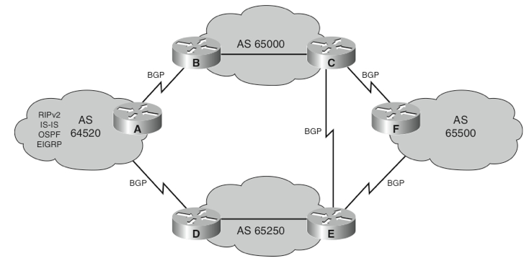
BGP Use Between Autonomous Systems
Main goal is to provide an interdomain routing systems that guarantees the loop-free exchange of routing information between AS’s.
BGP is a successor to Exterior Gateway Protocol (EGP). (Note the dual use of the EGP acronym.)
BGP-4 is a classless routing protocol so it supports:
  VLSM
  CIDR
    There are more than 300,000 CIDR blocks
    Without CIDR full Internet routing tables would contain more than 2,000,000 entries.

Slide 7
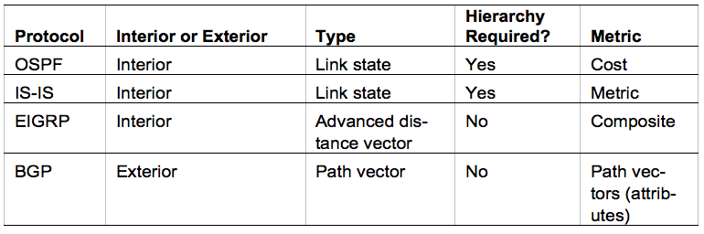
Comparison with Other Scalable Routing Protocols
BGP does not look at speed for the best path.
BGP is a policy-based routing protocol that allows an AS to control traffic flow using multiple BGP attributes.
Routers exchange network reachability information, called path vectors or attributes
    These include a list of the full path of BGP AS numbers that a router should take to reach a destination network.

Slide 8
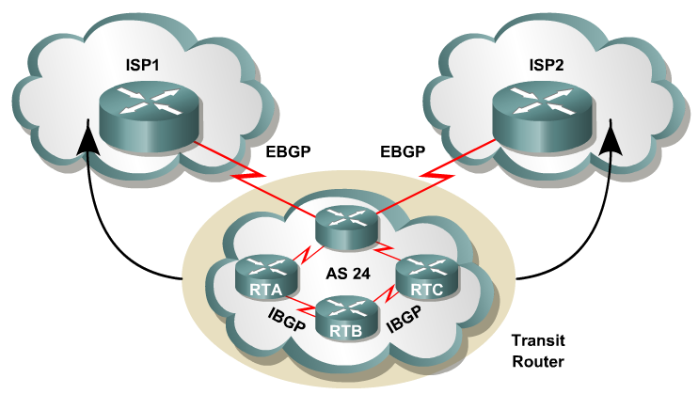
When to use BGP and when not to use BGP
Use BGP when the effects of BGP are well understood and one of the following conditions exist:
  The AS allows packets to transit through it to reach another AS (transit AS).
  The AS has multiple connections to other AS’s.
  The flow of traffic entering or exiting the AS must be manipulated.
    This is policy based routing and based on attributes.

Slide 9
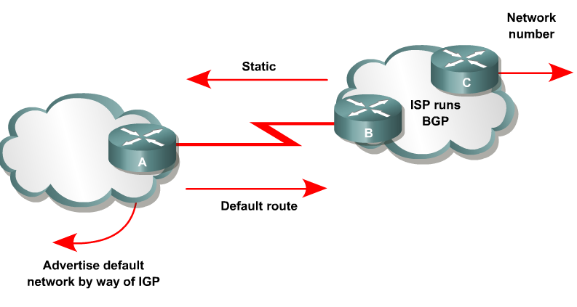
When to use BGP and when not to use BGP
Do not use BGP if you have one or more of the following conditions:
A single connection to the Internet or another AS
No concern for routing policy or routing selection
A lack of memory or processing power on your routers to handle constant BGP updates
A limited understanding of route filtering and BGP path selection process
Low bandwidth between AS’s

Slide 10
Overview of autonomous systems
AS - A group of routers that share similar routing policies and operate within a single administrative domain.
An AS can be a:
  Collection of routers running a single IGP (Single company)
  Collection of routers running different protocols all belonging to one organization (ISP).
In either case, the outside world views the entire Autonomous System as a single entity.

Slide 11
Overview of autonomous systems
AS Numbers
Assigned by an Internet registry or a service provider.
Between 1 and 65,535.
0 - Reserved
1 through 64,495 – Assignable for public use
64,512 through 65,535 - Private use
  This is similar to RFC 1918 IP addresses.
65,535 - Reserved
Because of the finite number of available AS numbers, an organization must present justification of its need before it will be assigned an AS number.

Slide 12
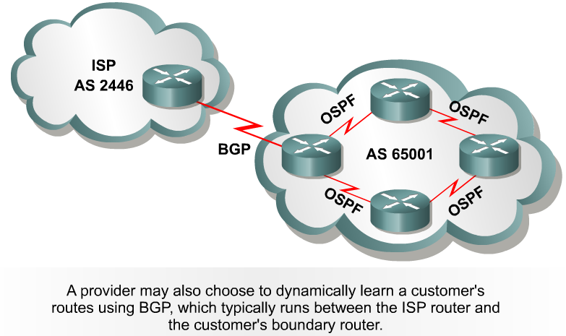
Today, the Internet Assigned Numbers Authority (IANA) is enforcing a policy whereby organizations that connect to a single provider and share the provider's routing policies use an AS number from the private pool, 64,512 to 65,535.

Slide 13
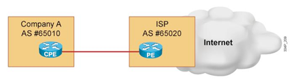
Using BGP
BGP dynamically exchanges routing information
BGP reacts to topology changes including those changes beyond a customer-to-ISP link failure.

Slide 14
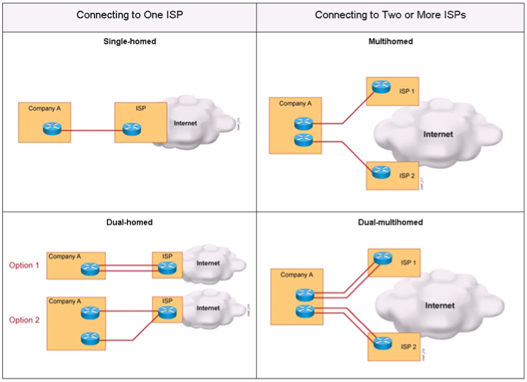
Connection Redundancy
  The ISP connection can also be made redundant.
  A customer can be connected to a single ISP or to multiple ISPs.

Slide 15
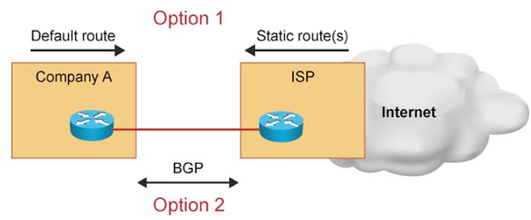
Single-homed autonomous systems
Single-homed system AS
  One Link per ISP, One ISP
  Only one exit point to outside networks.
  Often referred to as stub networks or stubs.
  Usually use a default route to handle all traffic destined for non-local networks.
BGP is not normally needed in this situation.

Slide 16
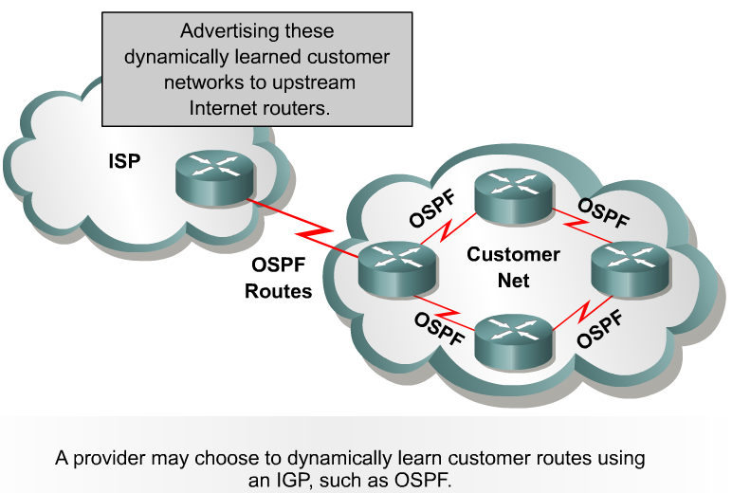
Single-homed autonomous systems
IGP Option
IGP: Both the provider and the customer use an IGP to share information regarding the customer's networks.
Customer:
  Sends public network address
  Receives default route

Slide 17
Single-homed autonomous systems
BGP Option
In a single-homed autonomous system the customer's routing policies are an extension of the policies of the provider.
  Internet number registries are unlikely to assign public AS number.
  AS number from the private pool of AS numbers, 64,512 to 65,535.
  The provider will strip off these numbers when advertising the customer's routes towards the core of the Internet.

Slide 18
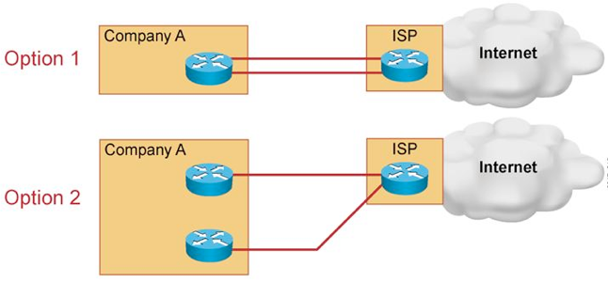
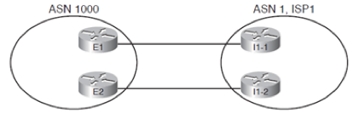
Dual Homed
Option 3
Dual-homed AS
Two or more links per ISP, One ISP
Same options as single-homed
Additional advantages:
  Primary and backup link functionality
  Load Balancing

Slide 19
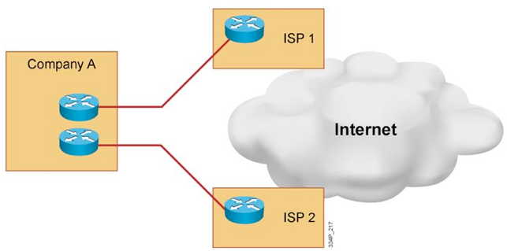
Single Multi-homed
Multi-homed or Single Multi-homed
One link per ISP, two or more ISPs
Typically recommended to run BGP
Options:
  ISP1 and ISP2: Full Internet routes
  ISP1: Full Internet routes; ISP2: Partial updates (selected)
  ISP1: Default route; ISP2: Partial updates (selected)

Slide 20
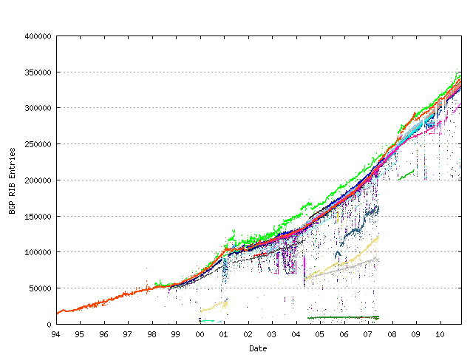
Caution in receiving full Internet routes:
  Over 300,000 summarized routes (over 2,000,000 un-summarized)
  100,000 routes require about 70 MB of RAM for the BGP table.

Slide 21
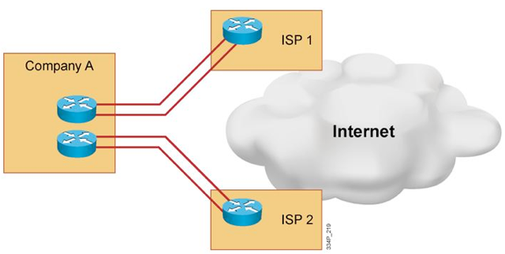
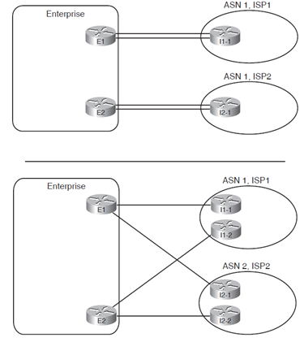
Dual Multi-homed
Dual Multi-homed
Two or more links per ISP, Two or more ISPs
Similar options as Single Multi-homed
Same benefits as single multi-homed but with enhanced resiliency.

Slide 22
Using BGP in an Enterprise Network
External BGP (EBGP) - When BGP is running between routers in different autonomous systems.
Internal BGP (IBGP) - When BGP is running between routers in the same AS.
Understanding how BGP works is important to avoid creating problems for your AS as a result of running BGP.

Slide 23
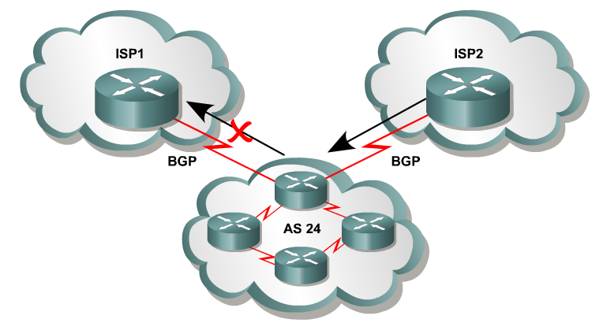
Transit
AS
Multihomed system
  More than one exit point to outside networks.
  May be a:
    Transit
    Non-transit AS
Transit traffic -Traffic that has a source and destination outside the AS.
Transit AS - allows transit traffic
Non-transit AS - does not allow transit traffic.
  Advertises only its own routes to both the providers
  Does not advertise routes it learned from one provider to another.
  Therefore, ISP1 will not use AS 24 to reach destinations that belong to ISP2 and visa versa.

Slide 24
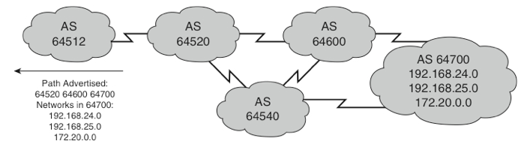
BGP Path Vector Characteristics
Path Advertised:
64520 64600 64700
Networks in AS 64700:
192.168.24.0
192.168.25.0
172.20.0.0
IGP routing protocols use metrics to determine best path.
  Cost (Bandwidth), BW+DLY-REL-Load, Hop Count
BGP routers exchange network reachability information, called path vectors, made up of path attributes
The path vector information includes a list of the full path of BGP AS numbers (hop-by-hop) necessary to reach a destination network.
Other attributes include:
  IP address of the next-hop AS (the next-hop attribute)
  How the network was introduced into BGP (the origin code attribute)

Slide 25
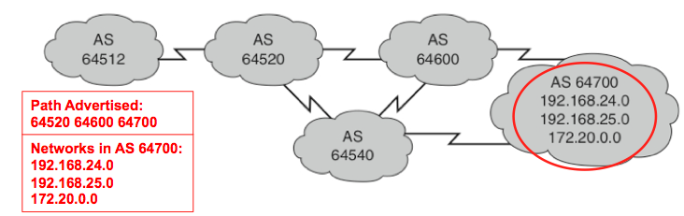
AS Path information is used to construct a graph of loop-free AS’s and to identify routing policies.
AS 64512: AS Path to 192.168.24.0 = 64520 > 64600 > 64700
BGP AS Path is guaranteed to be loop free.
  BGP router does not accept a routing update that already includes its own AS number in the AS Path list.

Slide 26
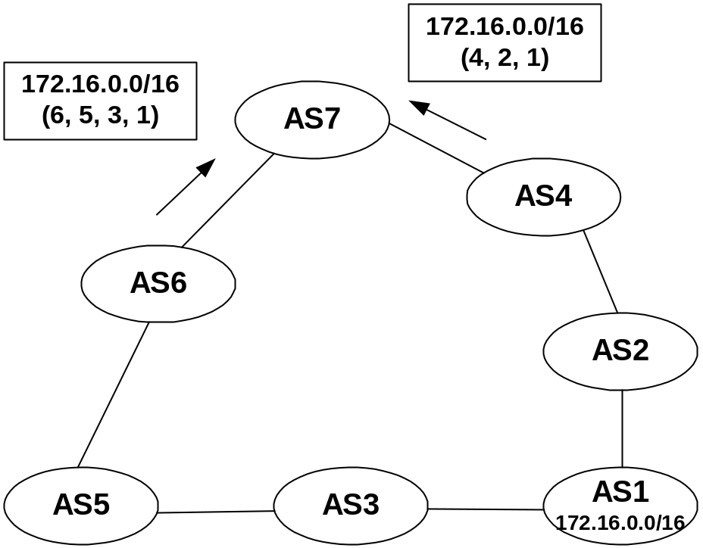
Loop Free Path
AS_PATH
  List of AS numbers associated with a BGP route
  One of several path attributes associated with each route.
The shortest inter-AS path is very simply determined by the least number of AS numbers.
In this example, AS7 will choose the shortest path (4, 2, 1).

Slide 27
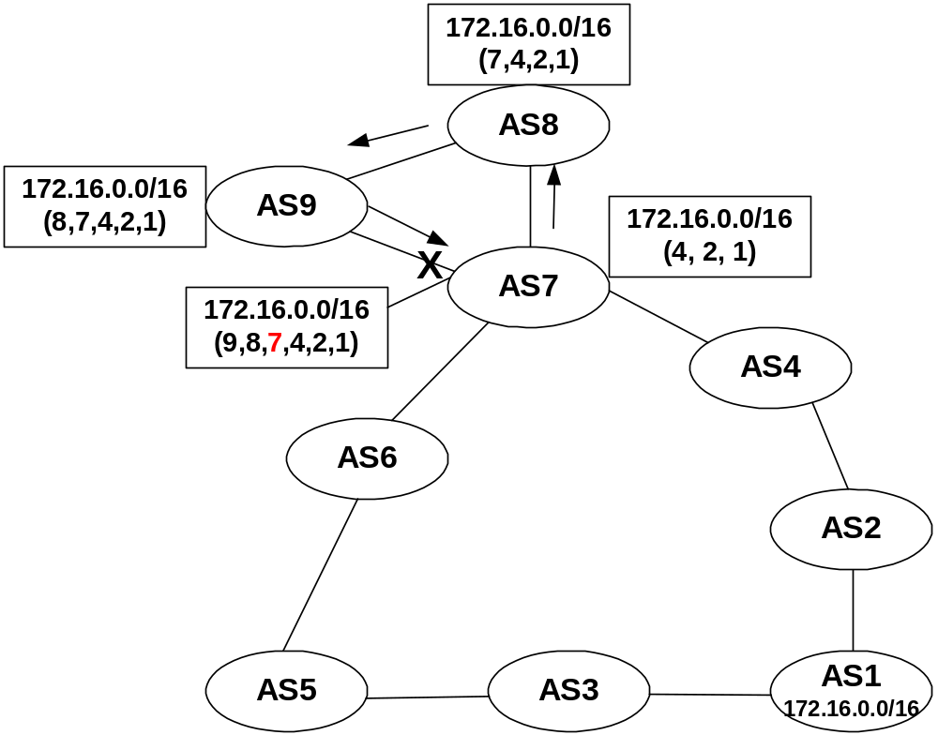
Loop Free Path
Routing Loop Avoidance
Route loops can be easily detected when a router receives an update containing its local AS number in the AS_PATH.
When this occurs, the router will not accept the update, thereby avoiding a potential routing loop.

Slide 28
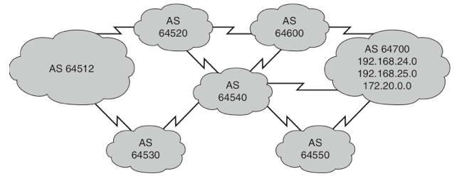
Possible paths for AS 64512 to reach networks in AS 64700, through AS 64520:
  64520 64600 64700
  64520 64600 64540 64550 64700
  64520 64540 64600 64700
  64520 64540 64550 64700
AS 64512 does NOT see all these possibilities.
AS 64520 advertises to AS 64512 only its best path:
  64520 64600 64700 (assuming no other policies supersede AS Path)
AS 64512 could also get a best path from AS 64530
AS 64512 would then decide which path is best (via 64530 or via 64520) based on its own AS policies.

Slide 29
BGP Characteristics
BGP updates are carried using TCP on port 179.
  In contrast:
    RIP updates use UDP port 520
    EIGRP uses EIGRP’s RTP
    OSPF does not use a Layer 4 protocol but uses OSPF mechanisms for reliability (OSPF ACKs)
Because BGP requires TCP:
  IP connectivity must exist between BGP peers.
  TCP connections must also be negotiated between them before updates can be exchanged.
BGP inherits those reliable, connection-oriented properties from TCP.
  Flow control properties as well (sliding windows)
BGP assumes that its communication is reliable and therefore, BGP does not have to implement any retransmission or error-recovery mechanisms, like OSPF does.

Slide 30
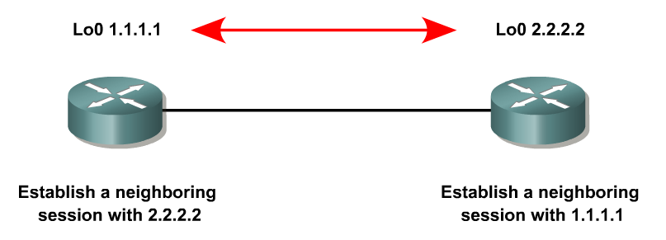
BGP Neighbor Relationships
Neighbors or peers - Two routers that establish a TCP-enabled BGP connection between each other.
BGP speaker - Each router running BGP.
A BGP speaker has a limited number of BGP neighbors with which it peers and forms a TCP-based relationship.
BGP peers can be either:
  Internal to the AS
  External to the AS

Slide 31
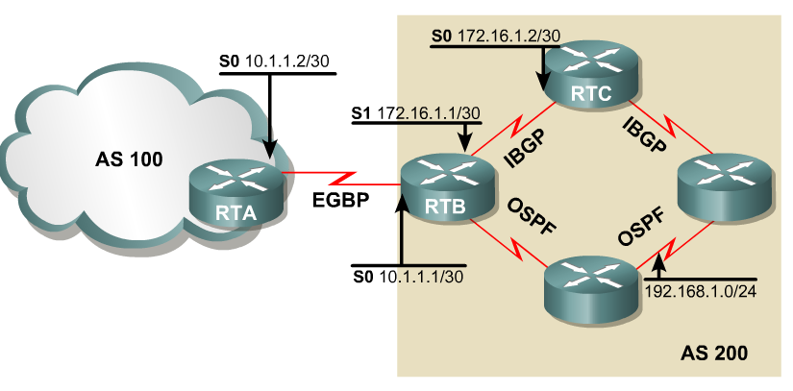


External BGP Neighbors
EBGP: BGP is running between routers in different autonomous systems.
Routers running EBGP are “usually” directly connected to each other
  EBGP multi-hop allows EBGP neighbors not to be directly connected.

Slide 32
There are several requirements for EBGP neighborship:
Different AS number:
  EBGP neighbors must reside in different autonomous systems to be able to form an EBGP relationship.
Define neighbors:
  A TCP session must be established prior to starting BGP routing update exchanges.
Reachability:
  The IP addresses used in the neighbor command must be reachable
  EBGP neighbors are “usually” directly connected.

Slide 33
EBGP
RTA(config)#router bgp 100
RTA(config-router)#
RTB(config)#router bgp 200
RTB(config-router)#
Configuring EBGP neighbors.
To begin configuring a BGP process, issue the following familiar command:
Router(config)#router bgp AS-number
BGP configuration commands appear similar to familiar IGP but it is different!
Because the two AS numbers are different, BGP will start an EBGP connection with RTA.

Slide 34
EBGP
RTA(config)#router bgp 100
RTA(config-router)#neighbor 10.1.1.1 remote-as 200
RTB(config)#router bgp 200
RTB(config-router)#neighbor 10.1.1.2 remote-as 100
Configuring EBGP neighbors
Neighbor command - Used to establish a neighbor relationship with another BGP router.
Router(config-router)#neighbor ip-address remote-as AS-number
Identifies a peer router with which the local router will establish a session.
The AS-number argument determines whether the neighbor router is an EBGP or an IBGP neighbor
  Different AS numbers mean EBGP peers
  Same AS numbers mean IBG peers

Slide 35
Internal BGP Neighbors
IBGP: When BGP is running between routers within the same AS
IBGP is run within an AS to exchange BGP information so that:
  All internal BGP routers have the same BGP routing information about outside autonomous systems
  This information can be passed to other autonomous systems.
  Typically full-mesh on all routers in the transit path between AS’s.

Slide 36
There are several requirements for IBGP neighborship:
Same AS number:
  IBGP neighbors must reside in the same AS to be able to form an IBGP relationship.
Define neighbors:
  A TCP session must be established between neighbors prior to start exchanging BGP routing updates.
Reachability:
  IBGP neighbors must be reachable; an IGP typically runs inside the AS.
  Do not have to be directly connected.

Slide 37
RTB(config)#router bgp 200
RTB(config-router)#neighbor 172.16.1.2 remote-as 200
RTC(config)#router bgp 200
RTC(config-router)#neighbor 172.16.1.1 remote-as 200
The remote-as value (200) is the same, routers will attempt to establish an IBGP session.
Note: AS 200 is not a remote AS , for simplicity, the keyword remote-as is used.

Slide 38
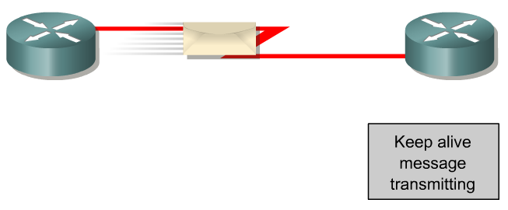
How does BGP choose the best path?
Is this the best path? Does it meet the path selection criteria? If so, add to routing table.
BGP Update
BGP Table
Routing Table
Network
Network
BGP selects only one path as the best path.
When the path is selected, BGP puts the selected path in its routing table and propagates the path to its neighbors.

Slide 39
BGP Message Types
Before establishing a BGP peer connection the two neighbors must perform the standard TCP three-way handshake and open a TCP connection to port 179.
After the TCP session is established, BGP peers exchanges several messages to open and confirm connection parameters and to send BGP routing information.
All BGP messages are unicast to the one neighbor over the TCP connection.
There are four BGP message types:
  Type 1: OPEN
  Type 2: KEEPALIVE
  Type 3: UPDATE
  Type 4: NOTIFICATION

Slide 40
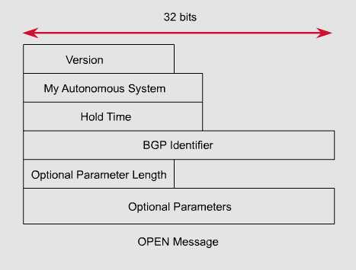
Type 1: BGP Open Message
After the TCP session is established, both neighbors send Open messages.
This message is used to establish connections with peers.
Each neighbor uses this message to identify itself and to specify its BGP operational parameters including:
  BGP version number (defaults to version 4)
  AS number: AS number of the originating router, determines if BGP session is EBGP or IBGP.
  BGP identifier: IP address that identifies the neighbor using the same method as OSPF router ID.
  Optional parameter: authentication, multiprotocol support and route refresh.

Slide 41
Type 2: BGP Keepalive Message
This message type is sent periodically between peers to maintain connections and verify paths held by the router sending the keepalive.
If a router accepts the parameters specified in its neighbor’s Open message, it responds with a Keepalive.
Subsequent Keepalives are sent every 60 seconds
Holdtime: The maximum number of seconds that can elapse between successive keepalives or update messages.
  Default holdtime is 180 seconds
  Will use the smaller of the two neighbor holdtimes.
Router ID is included (determined same as OSPF or EIGRP Router ID)

Slide 42
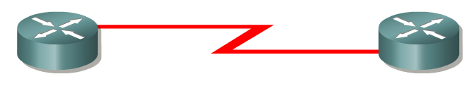
Type 3: BGP Update Message
The UPDATE messages contain all the information BGP uses to construct a loop-free picture of the internetwork.
Update messages advertises feasible routes, withdrawn routes, or both.
The three basic components of an UPDATE message are:
  Network-Layer Reachability Information (NLRI)
  Path Attributes
  Withdrawn Routes

Slide 43
Type 3: BGP Update Message
Attributes
…
Networks
…
Attributes
…
Networks
…
Attributes
…
Networks
…
Path
Path
Path
Update message includes Paths and associated Attributes and Networks
Path Attributes
This is information that allows BGP to choose a shortest path, detect routing loops, and determine routing policy.
Withdrawn Routes
These are (Length, Prefix) tuples describing destination that have become unreachable and are being withdrawn from service.
Network-Layer Reachability Information (NLRI)
This is one or more networks (IP address prefix and prefix lengths) that can be reached by this path.

Slide 44
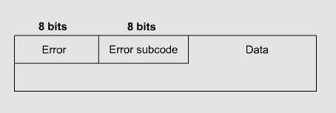
Type 4: BGP Notification Message
A NOTIFICATION message is sent whenever an error is detected and always causes the BGP connection to close.
The NOTIFICATION message is composed of the Error Code (8 bits), Error Subcode (8 bits), and a Data fields (variable length).

Slide 45
Review Questions
1. Which are the four kinds of message types in BGP and their function?
2. What are the well-known mandatory attributes in BGP and their function?
3. What is the function of configuring multi-hop in BGP?

